Slide 1

Operator overloading

Slide 2
Subscript operator [ ]
With the help of [ ] operator, we can define array style syntax for accessing or assigning individual elements of classes
Student semesterGPA;
semesterGPA[0] = 3.5;
semesterGPA[1] = 3.3;

Slide 3
Subscript operator [ ]
class Student
{ private:
double gpa[8];
public:
Student ()
{ gpa[0]=3.5; gpa[1]=3.2; gpa[2]=4; gpa[3]=3.3;
gpa[4]=3.8; gpa[5]=3.6; gpa[6]=3.5; gpa[7]=3.8;
}
double& opeator[] (int Index);
}
double& Student::operator [ ] (int Index)
{
return gpa[Index];
}

Slide 4
Subscript operator [ ]
int main ( )
{
Student semesterGPA;
semesterGPA[0] = 3.7;
double gpa = semesterGPA[4];
}

Slide 5
Subscript operator [ ]
How does this statement execute?
semesterGPA[0] = 3.7;
The [ ] has higher priority than the assignment operator, therefore semesterGPA[0] is processed first.
semesterGPA[0] calls operator [ ], which then return a reference of semesterGPA.gpa[0].

Slide 6
Subscript operator [ ]
The return value is reference to semesterGPA.gpa[0], and the statement semesterGPA[0] = 3.7 is actually integer assignment
int main ( )
{
Student semesterGPA;
semesterGPA[0] = 3.7;
// the above statement is processed like as
semesterGPA.gpa[0] = 3.7
}

Slide 7
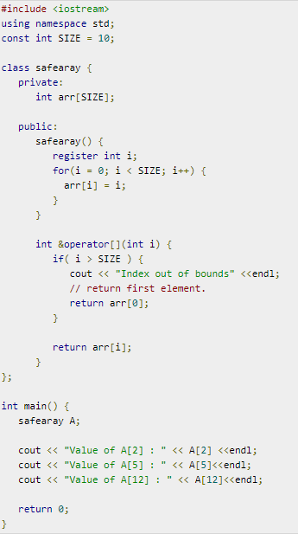
Notes:
Register is a request to compiler to store in register-memory instead of memory. Compiler may or may not do that.
https://www.tutorialspoint.com/cplusplus/subscripting_operator_overloading.htm

Slide 8
Parenthesis operator ()
Can only be overloaded as a member function
Can have any return type
Can have zero or more parameters
Implement any logic in the function

Slide 9
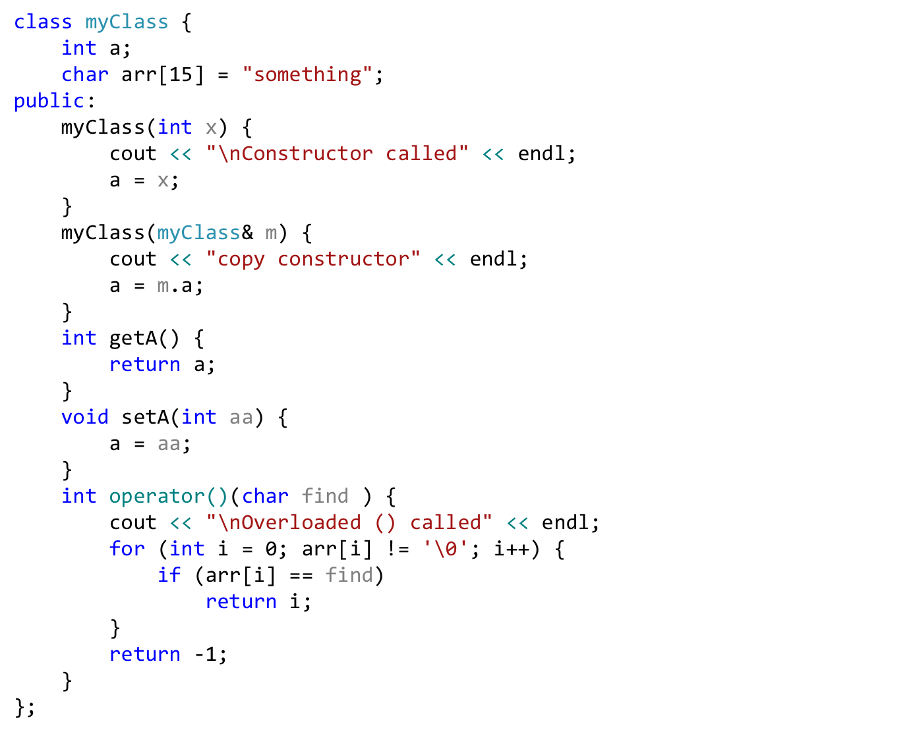
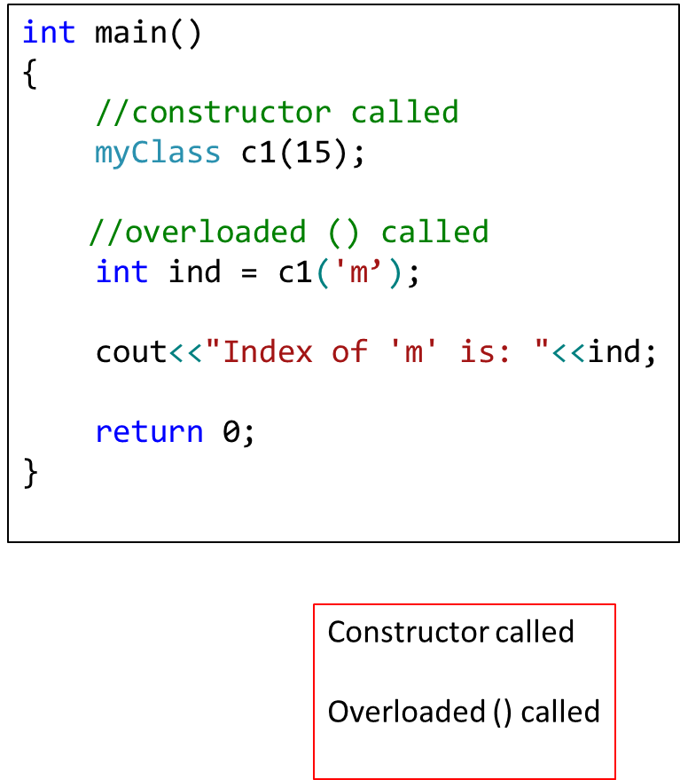

Slide 10
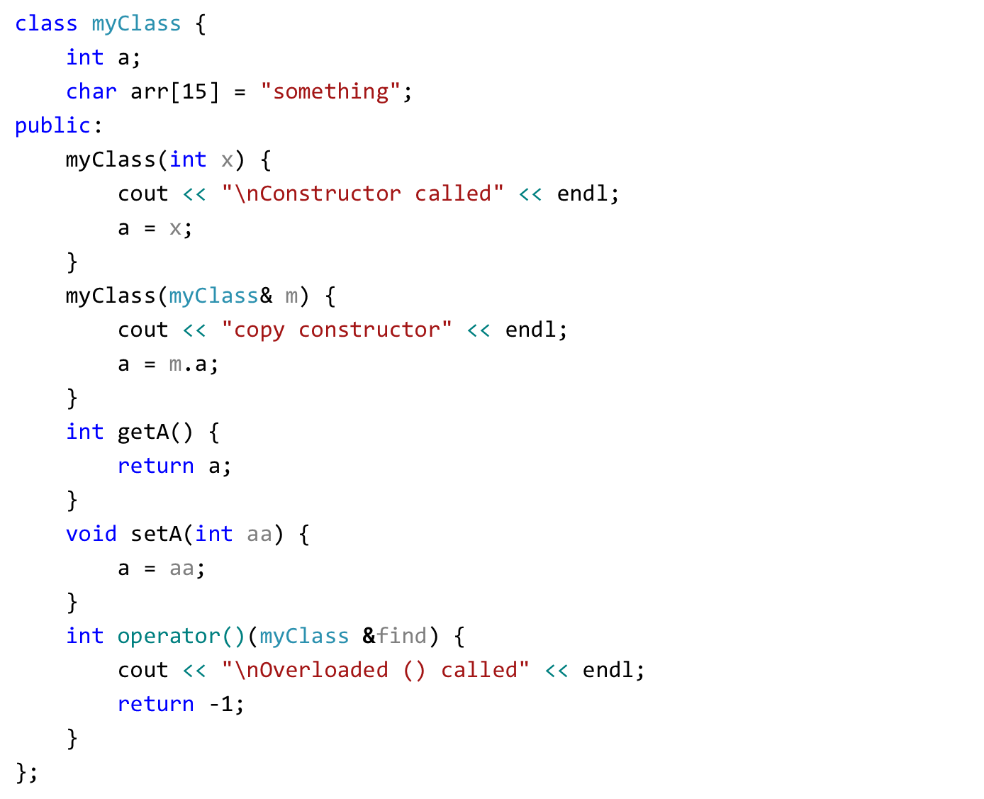
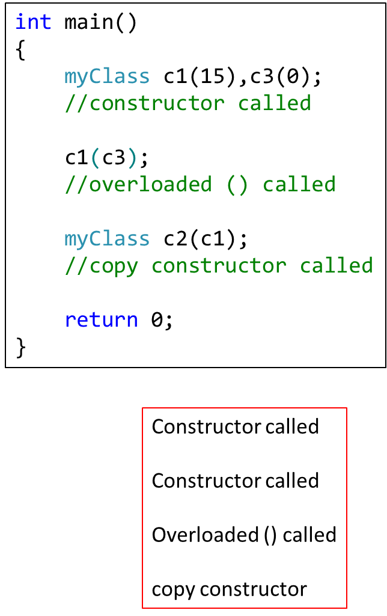

Slide 11
Calling an overloaded operator from native data types
int var;
Point object;
var = var + object;
In above example, it seems that we need to overload + operator for integer (native-data type).
But in operator overloading we can't change the functionality of integer (or any primitive) data type

Slide 12
Calling an overloaded operator from native data types
Friend functions can help solve this problem.
A Friend function does not need an object of a class for its calling.
Thus, with a simple trick we can set parameter1 of an overloaded operator to a native data type and parameter2 to class object.

Slide 13
Friend Functions
Friend functions: can be given special grant to access private and protected members.
Friends should be used only for limited purpose, too many functions declared as friends with protected or private data access, lessens the value of encapsulation

Slide 14
Calling an overloaded operator from native data types
For friend function the syntax is changed, the first operator is moved from calling object to first parameter of function.
friend datatype operator+ (datatype, datatype)
First parameter (can be native data type or user defined data type)
return parameter (can be native data type or user defined data type)
Second parameter (can be native data type or user defined data type)

Slide 15
Example
class Point
{
private:
float m_dX, m_dY, m_dZ;
public:
Point(float dX, float dY, float dZ)
{
m_dX = dX;
m_dY = dY;
m_dZ = dZ;
}
friend float operator+ (float, Point &);
};

Slide 16
Example
float operator+(float var1, Point &p)
{
return ( var1 + p.m_dX);
}
int main (void)
{
float variable = 5.6;
Point cPoint ( 2, 9.8, 3.3 );
float returnVar;
returnVar = variable + cPoint;
cout << returnVar; // 7.6
return 0;
}

Slide 17
Overloading iostream operators >> and <<
stream insertion operator << is used for output
stream extraction operator >> is used for input
cout is an object of ostream class
cin is an object of istream class
These operators must be overloaded as a global function. And if we want to allow them to access private data members of the class, we must make them friend.

Slide 18
Point P1;
cout<<P1

Slide 19
Overloading iostream operators >> and <<
Why these operators must be overloaded as global?
Left operand with << and >> is always going to be cin and cout
if we want to make them a member function, then they must be made members of ostream and istream classes, not a good option.
Therefore, these operators are overloaded as global functions with two parameters, istream/ostream and object of user-defined class.

Slide 20
Overloading iostream operators >> and <<
We can use friend function for overloading iostream operators ( >> or <<).
Usually iostream operators ( >> or << ) are not called from an object of the class
Point p;
cin >> p;
cout << p;
where cin and cout are object of iostream class

Slide 21
Overloading iostream operators >> and <<
We can define the prototype of iostream operators ( >> and << ) inside a class with the help of friend function, and then we can access private data members.
We can also overload these operators without making friend functions

Slide 22
Example
class Point
{
private:
float m_dX, m_dY, m_dZ;
public:
Point(float dX, float dY, float dZ)
{
m_dX = dX;
m_dY = dY;
m_dZ = dZ;
}
friend ostream& operator<< (ostream &out, Point &cPoint);
friend istream& operator>> (istream &in, Point &cPoint);
};

Slide 23
Example
ostream& operator<< (ostream &out, Point &cPoint)
{
out << "(" << cPoint.m_dX << ", " <<
cPoint.m_dY << ", " << cPoint.m_dZ <<")";
return out;
}
istream& operator>> (istream &in, Point &cPoint)
{
in >> cPoint.m_dX;
in >> cPoint.m_dY;
in >> cPoint.m_dZ;
return in;
}

Slide 24
Example
int main (void)
{
cout << "Enter a point: " << endl;
Point cPoint;
cin >> cPoint;
cout << "You entered: " << cPoint << endl;
}

Slide 25
Overloading iostream operators >> and <<
But, what is the advantage of returning references of iostream objects
friend ostream& operator<< (ostream &out, Point &cPoint);
friend istream& operator>> (istream &in, Point &cPoint);
Supports chaining
Point cPoint1, cPoint2;
cin >> cPoint1 >> cPoint2;
In above statement (cin >> cPoint1) returns a reference of cin which is further used for ( cin >> cPoint2)

Slide 26
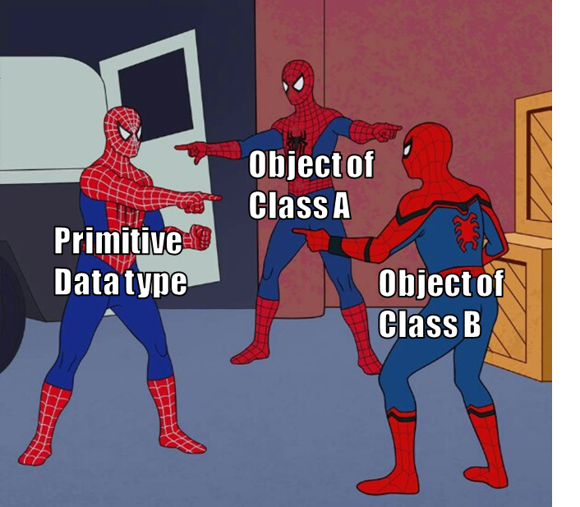
Data Conversion
Conversion between basic types
Conversion between Objects and basic types
Conversion between Objects of different classes

Slide 27
Implicit Conversion b/w Basic Types
When we use two different Types:
intvar = floatvar; //assign float to integer
the compiler calls a special function that converts this value from floating point format to integer
There are many such conversion routines build in C++ compiler and called upon when any such conversion is required.

Slide 28
Explicit Conversion b/w Basic Types
if we want to force compiler to convert data from one native type to other, we can use explicit type casting,
intvar = int(floatvar);
it is obvious in listing that int( ) conversion function will convert from float to int.
This explicit conversion uses same build in routines.

Slide 29
Conversion Between Objects and Basic Types
To convert from a basic type ( i.e., float) to object types (i.e., Distance), we use a constructor with one argument.
Distance(float meters){ }
This function is called when an object of type Distance is created with a single argument.
This conversion allows a float value to be assigned to a Distance type object.
Conversion occurs implicitly

Slide 30
Conversion Between Objects and Basic Types
Distance dist1 = 2.35; // constructor
Above, one argument constructor will be called.
Same conversion can be achieved by providing overloaded ‘=‘ operator which takes a float value as argument.

Slide 31
Conversion From User Defined to Basic
What if want to go from user-defined types(e.g. class Distance) to native type(e.g. float)?
The trick here is to overload the cast operator, creating something called a “Conversion function/operator”.
operator float() {
return floating_rep;
}
NOTE: the conversion function does not need return type
Conversion functions have no arguments, and the return type is implicitly the conversion type

Slide 32
Conversion From User Defined to Basic
This operator takes the value of the distance object of which it is a member, converts this value to a float value and returns this value.
This operator can be called like this:
Distance dist2;
float floatmtrs = float(dist2); //explicit conversion
float floatmtrs = dist2; //implicit conversion
both statements have exactly the same effect.

Slide 33
Conversion From User Defined to Basic
class Employee
{ private:
float salary;
public:
Employee ( float sal ) { salary = sal; }
operator float();
}
Employee::operator float( )
{
return salary;
}

Slide 34
Conversion From User Defined to Basic
int main ( )
{
Employee emp1(33.5);
float value = float(emp1);
cout << value; // 33.5
}

Slide 35
Conversion between Objects of Different Classes
Both methods shown before can be applied to conversion between objects
one argument constructor
conversion function

Slide 36
Example
There are two classes, Polar and Rec.
We want to be able to convert an object of type Polar to an object of type Rec.
Rec rec;
Polar pol;
rec = pol;
provide one argument constructor in class Rec.

Slide 37
Example
Rec(Polar p){
//process p’s data and convert(assign)
//it into object Rec.
}
rec = pol;
/*one argument constructor will be called to perform the conversion*/

Slide 38
Consequences of Operator Overloading and Conversion
With the help of Operator overloading we can create entirely new language.
For example for a = b + c we can implement a new methodology on user-defined types.
But care should be taken as doing something different than native data types could make your code hard to read and understand

Slide 39
Show Restraint
Make sure that user of your class will easily know the purpose of overloading an operator.
Sometimes it make more sense to use functions, as their names may suggest what they are to perform.
Use overloaded operator cautiously and only when the usage is obvious.

Slide 40
String Library
We will use operator overloading to build String library
Overloaded Operators
= (for text assignment)
== (for comparison between two strings)
ostream and istream (for cin and cout)
+ (for adding two strings)
[ ] (for retrieving or changing single character in string)

Slide 41
String Library
class String
{
private:
char *text;
public:
String(char *str)
{
text = new char[strlen(str)];
strcpy(text,str);
}
bool operator==(String &str);
bool operator==(char *str);
String& operator+(String &str);
String& operator+(char *str);
void operator= (char *str);
char& operator[] (int Index);
friend ostream& operator<<(ostream &,String &str);
friend istream& operator>>(istream &,String &str);
};

Slide 42
String Library
bool String::operator == ( char *str )
{
bool val;
val = strcmp(text,str);
if ( val == 0 )
return true;
else
return false;
}
bool String::operator == ( String &par)
{
bool val;
val = strcmp(text,par.text);
if ( val == 0 )
return true;
else
return false;
}

Slide 43
String Library
String& String::operator + (String &par)
{
String iSt = "";
int length = 0;
length = strlen(text);
length += strlen(par.text);
iSt.text = new char[length];
strcpy(iSt.text,text);
strcat(iSt.text,par.text);
return iSt;
}

Slide 44
String Library
String& String::operator + (char *str)
{
String iSt = "";
int length = 0;
length = strlen(text);
length += strlen(str);
iSt.text = new char[length];
strcpy(iSt.text,text);
strcat(iSt.text,str);
return iSt;
}

Slide 45
String Library
void String::operator = (char *str)
{
text = new char[ strlen(str) ];
strcpy(text,str);
}
char& String::[] (int Index)
{
return text[Index];
}
// String string1 = “hello”;
// string1[0] = ‘a’;
// string1.text[0] = ‘a’;
// char c = string1[0];

Slide 46
String Library
ostream& operator<< (ostream &out, String &str)
{
out << str.text;
return out;
}
istream& operator>> (istream &in, String &str)
{
char temp[200];
in >> temp;
text = new char[strlen(temp)];
strcpy(text,temp);
return in;
}

Slide 47
String Library
int main ( )
{
String string1 = “hello”;
String string2 = “”;
string1 = “hello world”;
cout << “Enter string 2 text” << endl;
cin >> string2;
if ( string1 == string2 )
cout << “Both strings are equal” << endl;
string2[0] = ‘a’;
string2[1] = ‘b’;
cout << “The second string is “ << string2 << endl;
cout << the first character is “<< string1[0] << endl;
}

